Slide 1
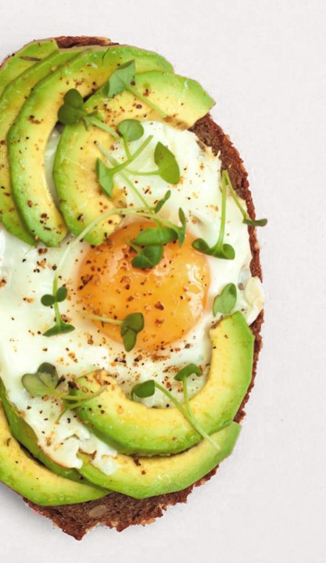
RESTAURANT RESERVATION SYSTEM
-A full-featured web application that streamlines the food ordering process in restaurants, with additional support for table reservations. It enables customers to browse the menu, place orders online, and optionally reserve tables, while allowing staff to manage orders, track reservations, and enhance overall service efficiency.

Slide 2
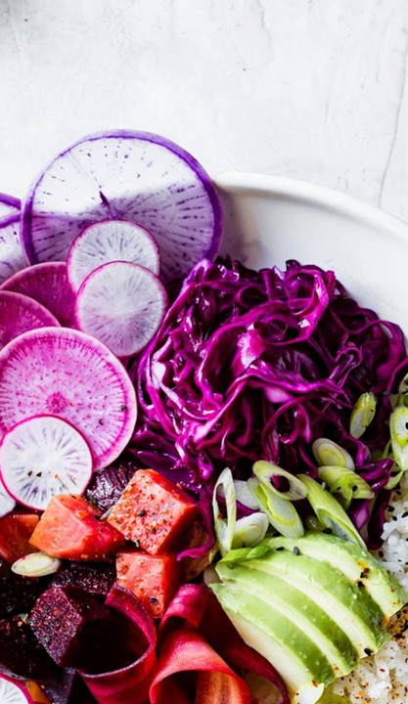
Team Details: 2310030108 – Santhosh 2310030130 – Afraz 2310030123 – Siddarth 2310030292 - Sashank
Team Members and Roles:
Member 1 – Frontend Development
Member 2 – Backend Development
Member 3 – Database Management
Member 4 – Testing & Documentation

Slide 3
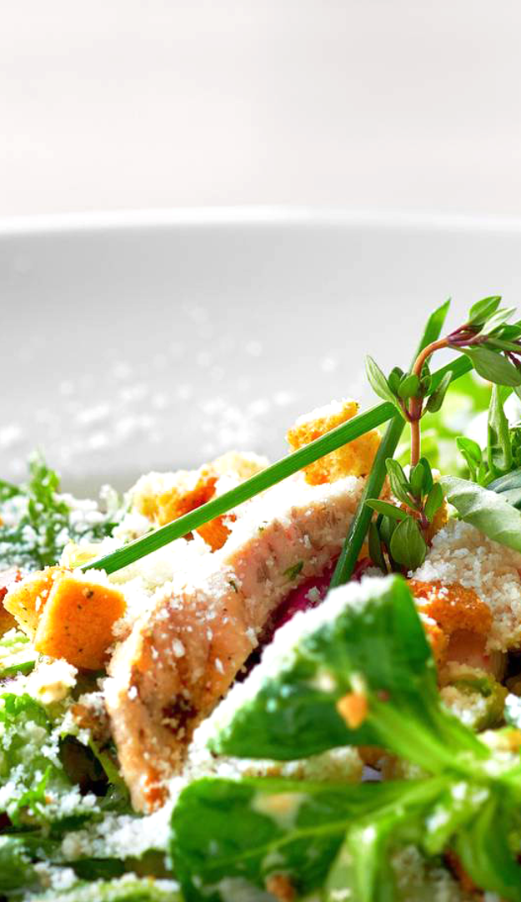
Project Goals & Objectives
Goals:
Develop a user-friendly web application for restaurant food ordering and table reservations.
Enhance customer convenience and improve restaurant operational efficiency.
Objectives:
Enable customers to browse menus and place real-time food orders.
Provide an intuitive interface for table booking.
Implement role-based access for customers, staff, and admins.
Ensure secure authentication and smooth user experience.
Maintain a scalable and manageable backend with efficient database integration.

Slide 4


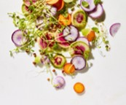
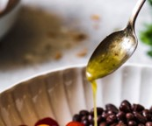
Core Features and Modules
Customer Module:
User registration and login
Browse menu and place food orders
Table reservation system
Order history and status tracking
Admin Module:
Manage customers
Add, update, or remove menu items
Track orders and reservations
Generate sales and booking reports
Common Features:
Role-based access (Customer & Admin)
Real-time order updates
Clean, responsive user interface

Slide 5

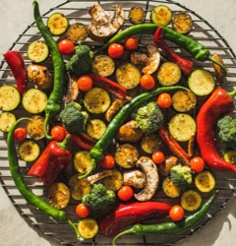
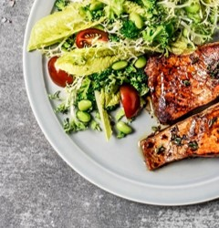
Restaurant Reservation System Architecture
Client Side (Vue.js)
User Interface Components
State Management (Vuex)
API Integration
Real-time Updates
Server Side (Node.js)
RESTful API Endpoints
Business Logic
Authentication/Authorization
Order Processing
Core Features
Online Food Ordering
Table Reservations
Kitchen Management
Payment Processing
Database (MySQL)
User Management
Menu & Inventory
Orders & Transactions
Table Management

Slide 6
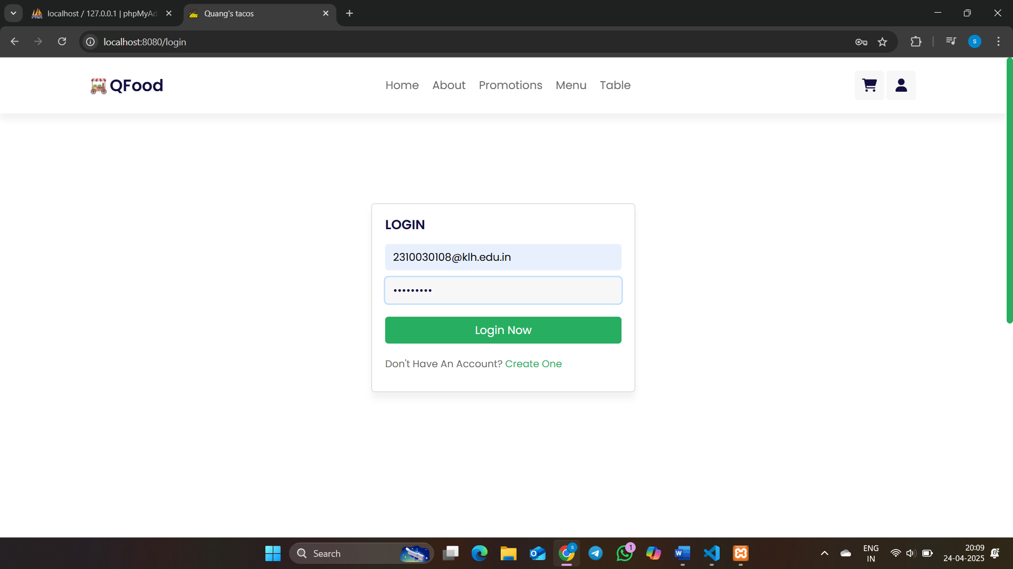
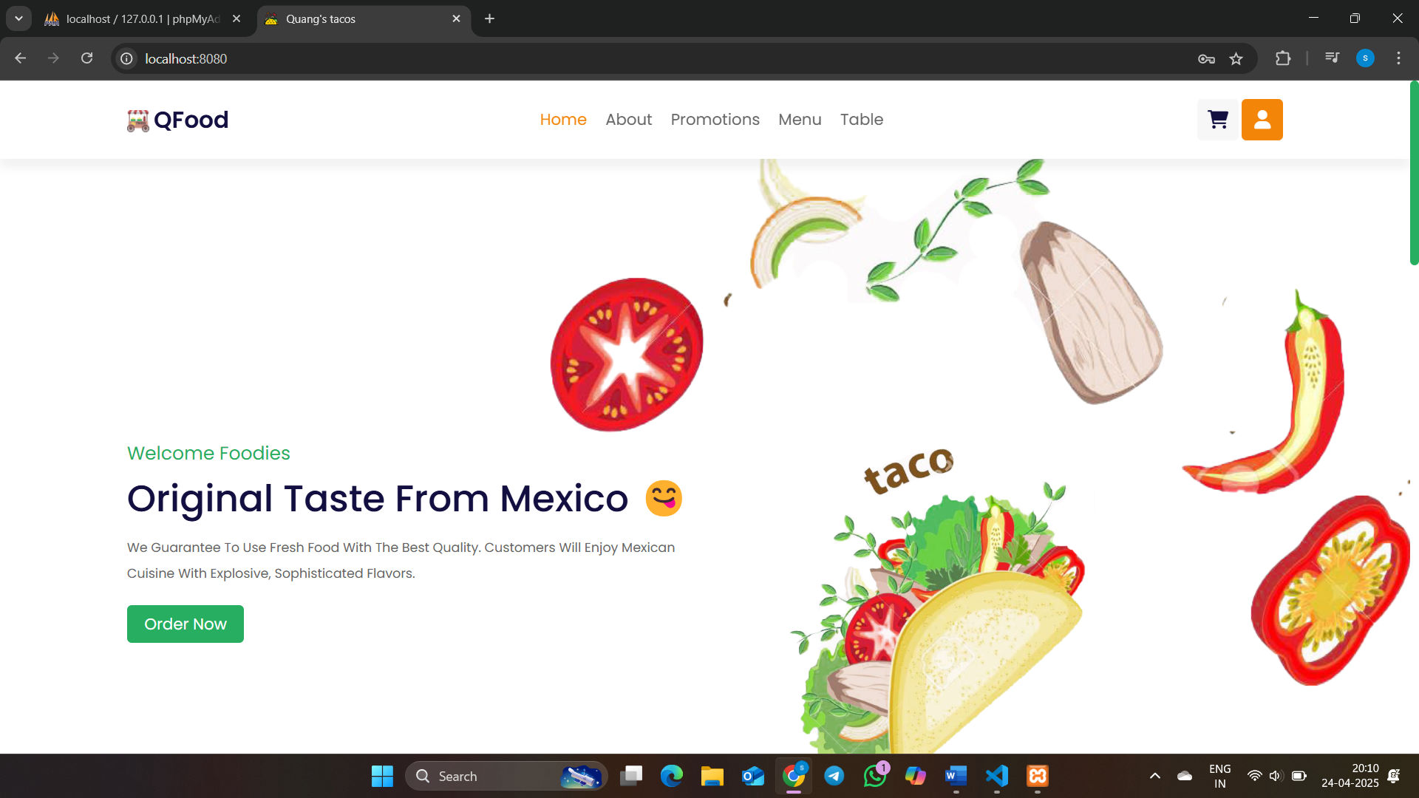
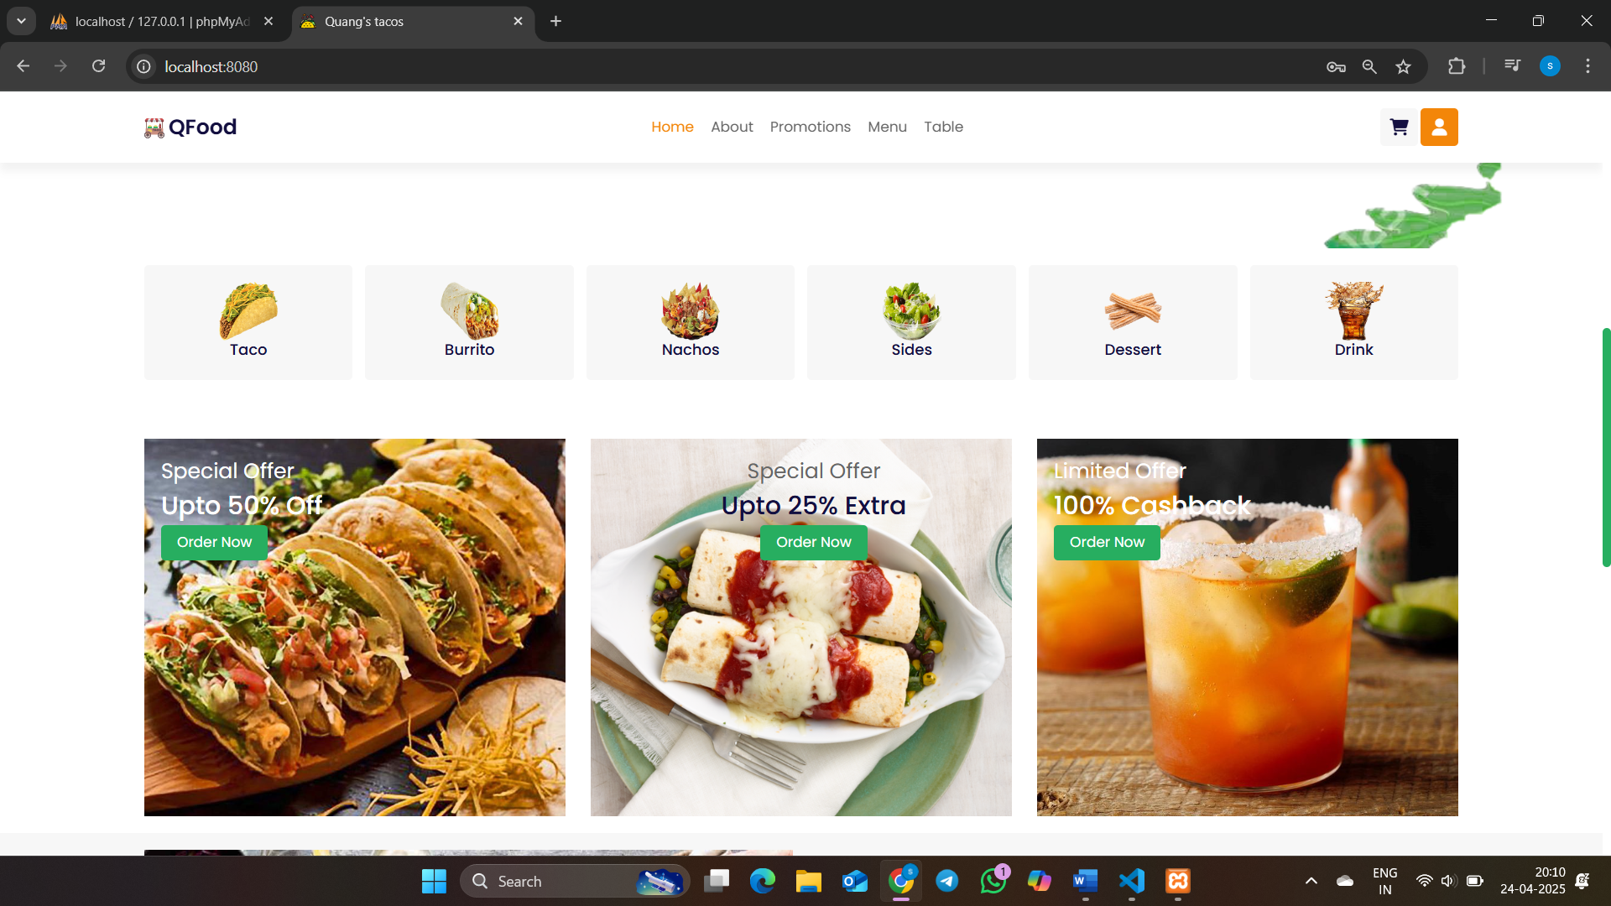
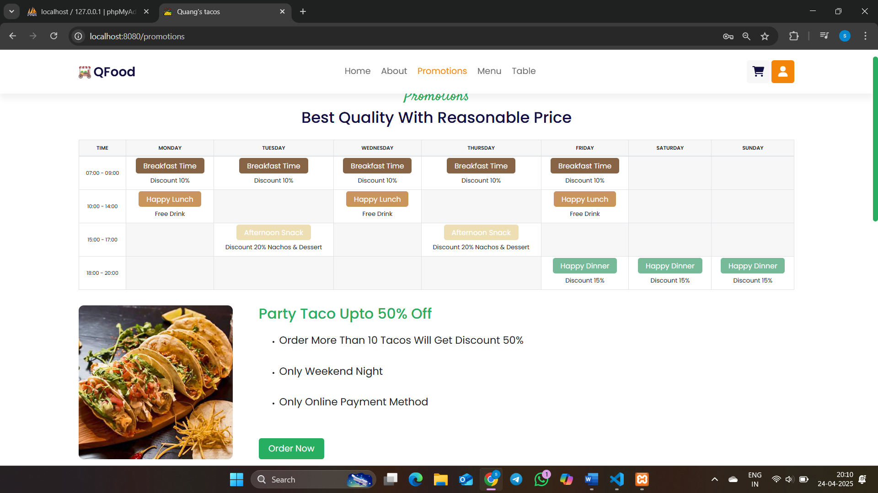
Overview Of The Project

Slide 7
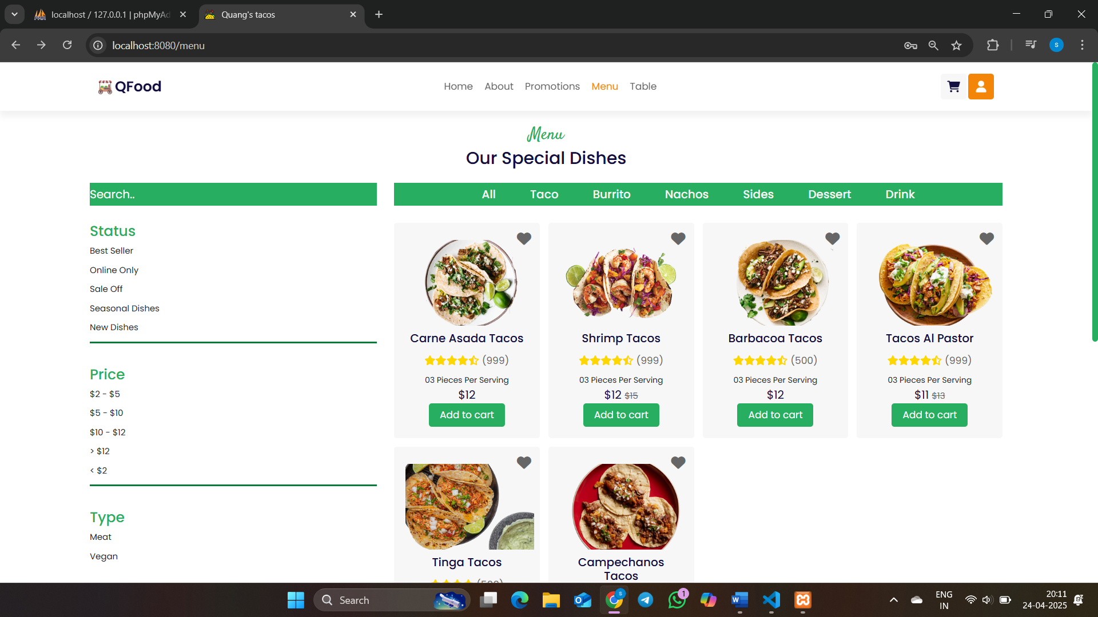
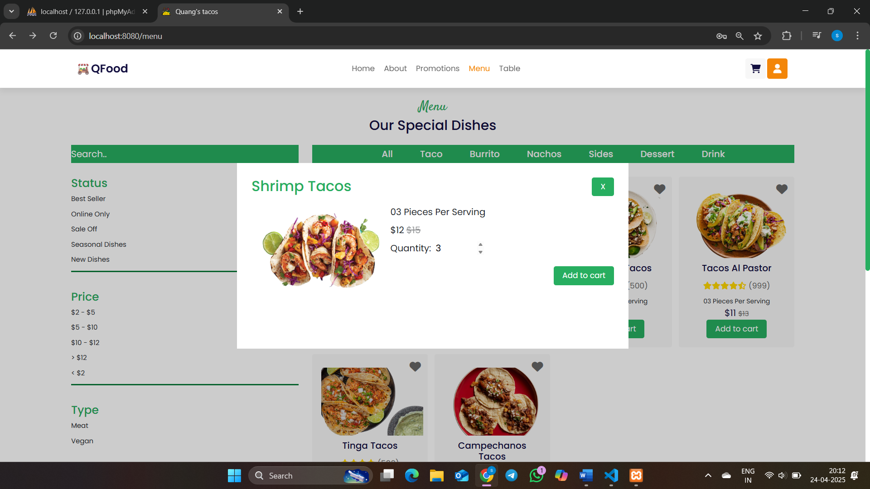
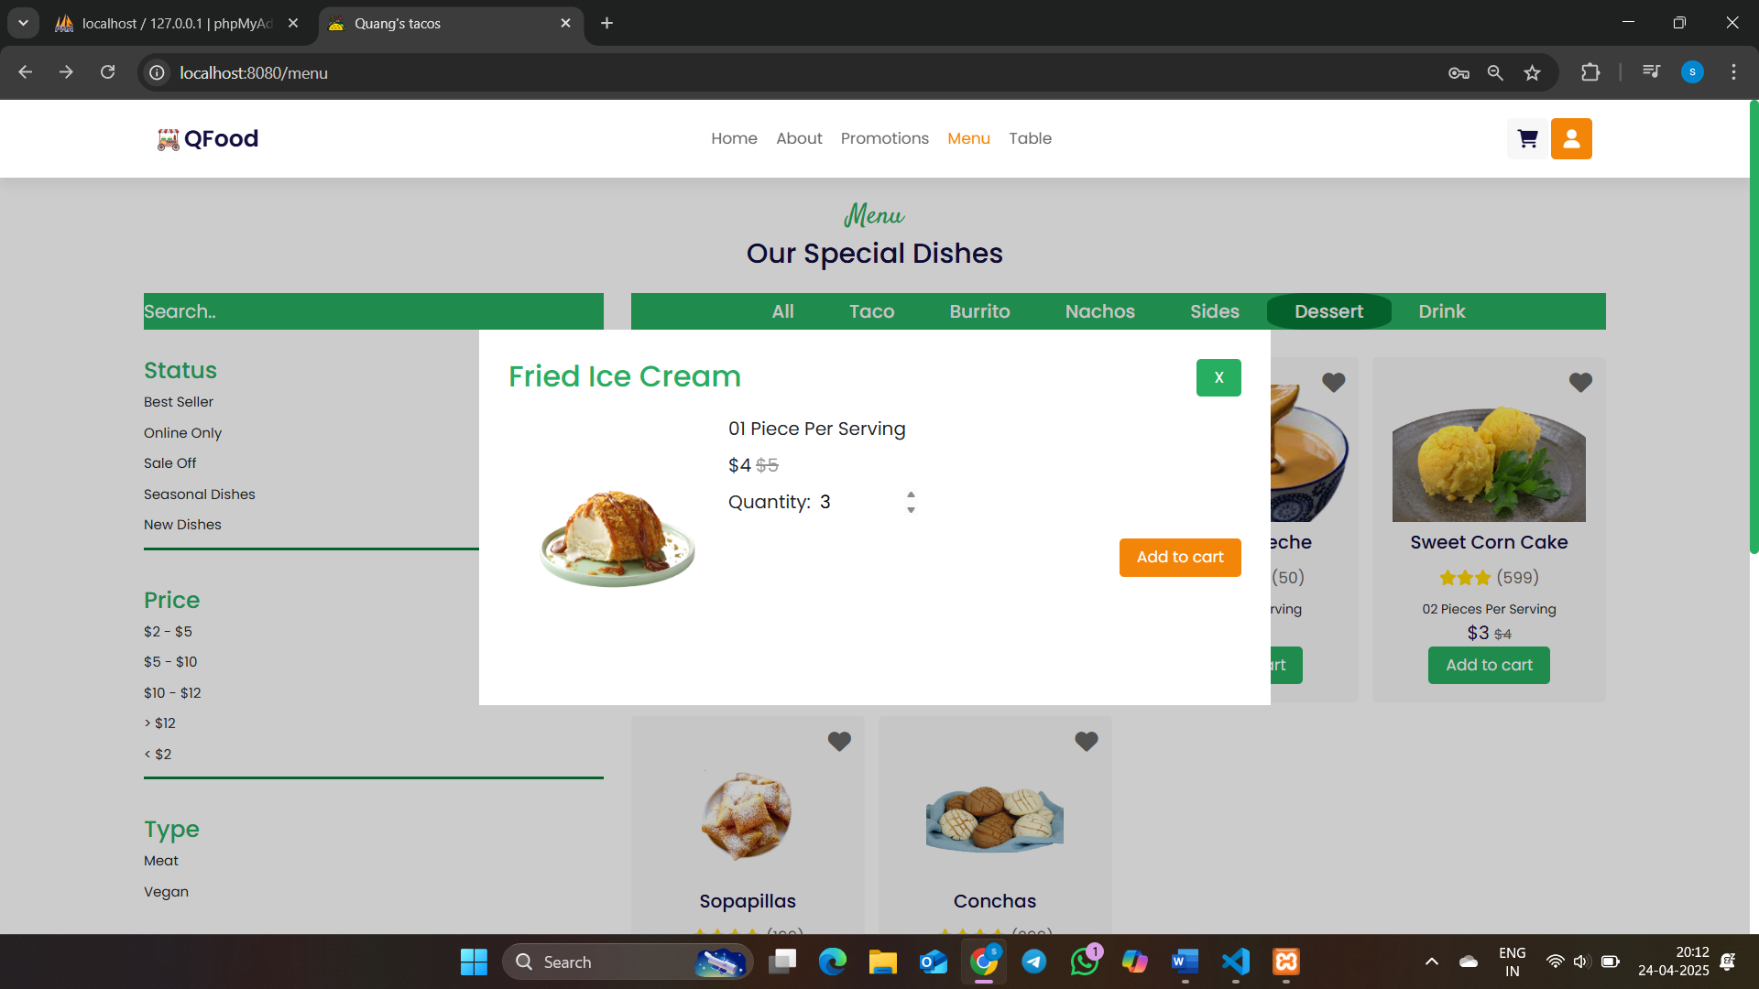
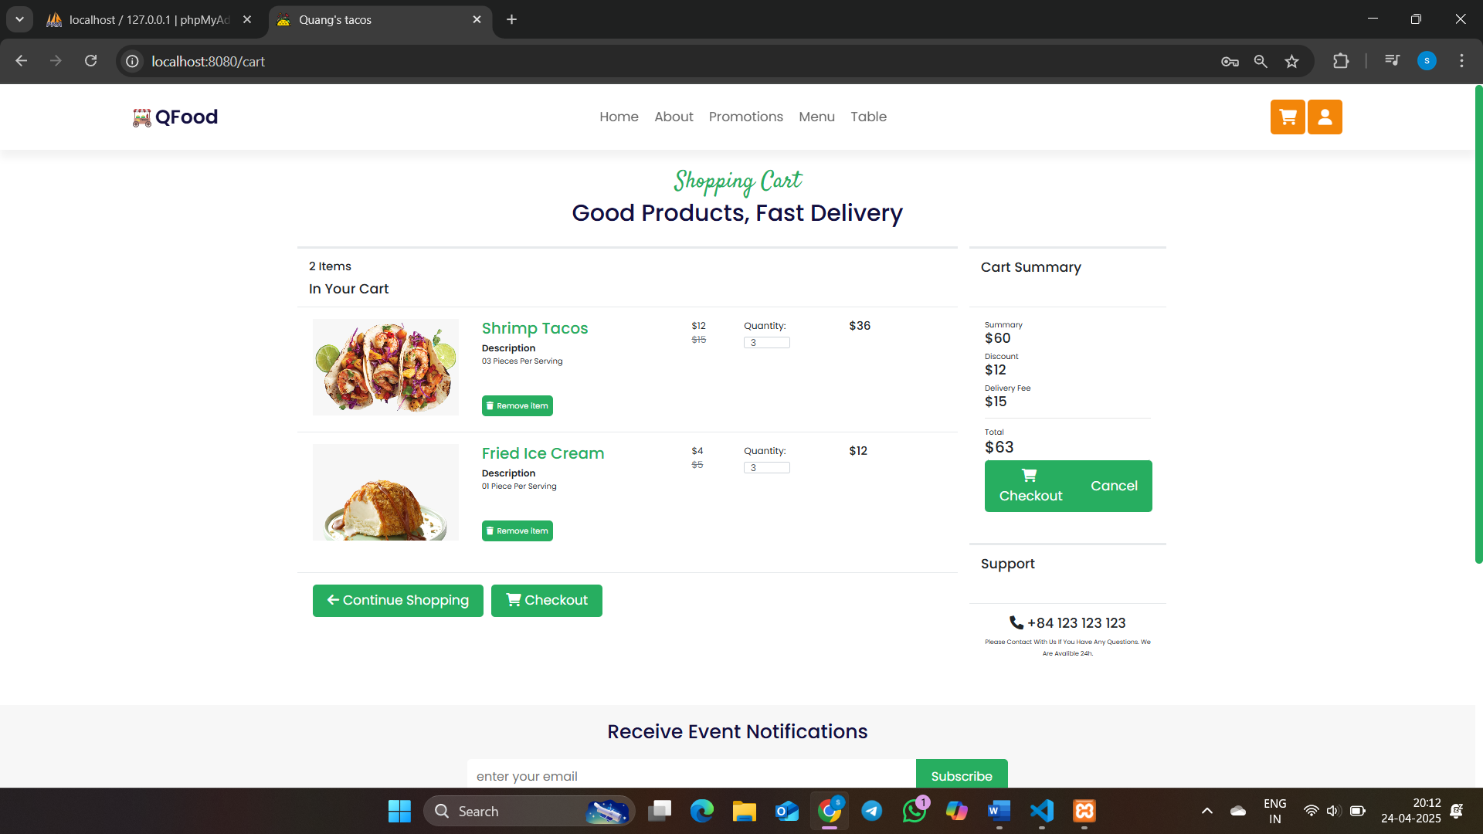

Slide 8
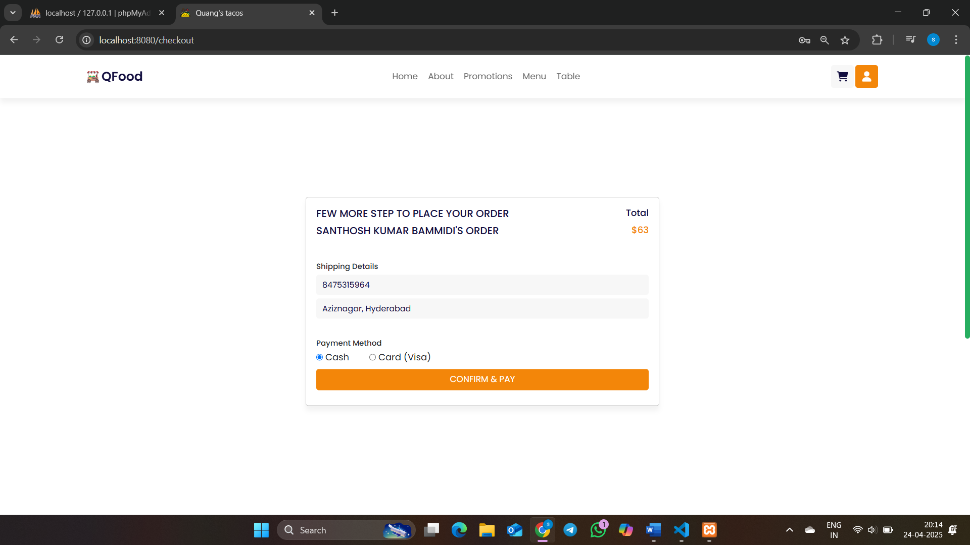
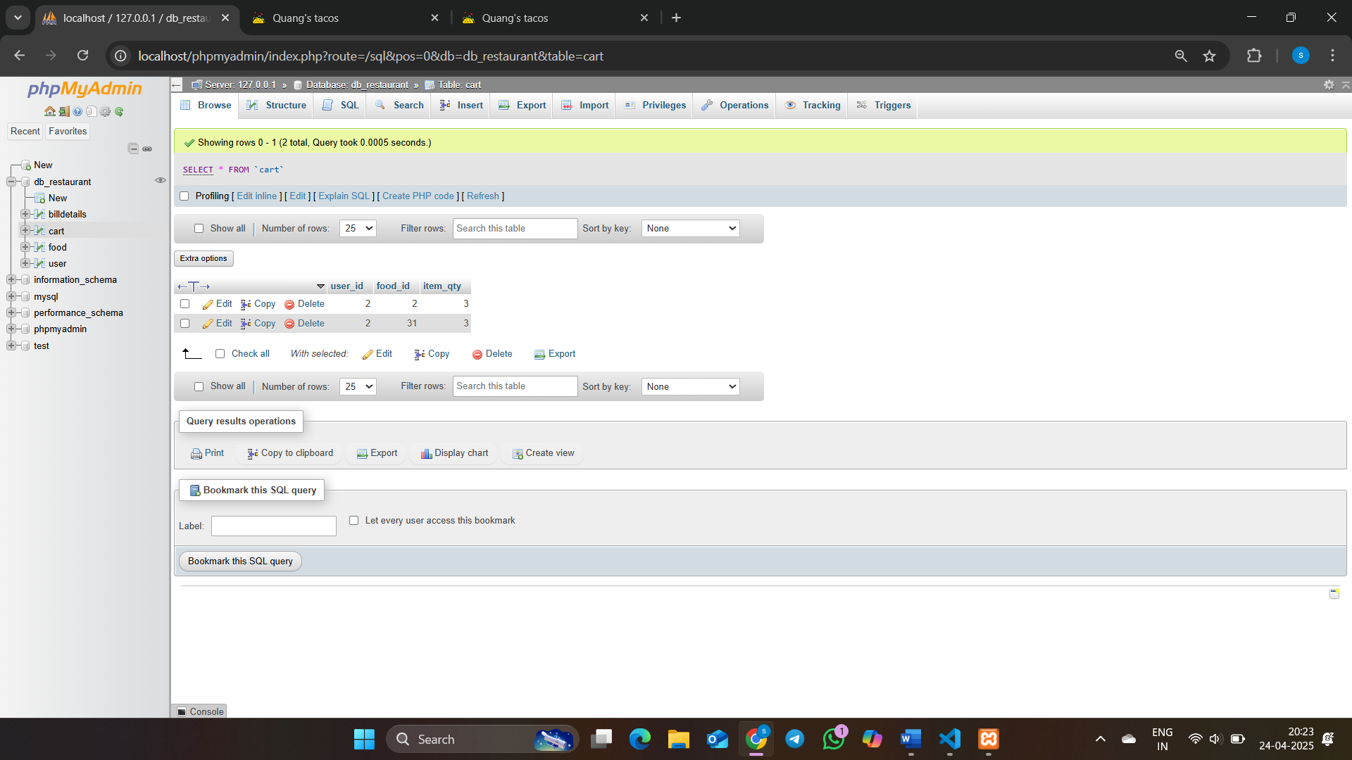
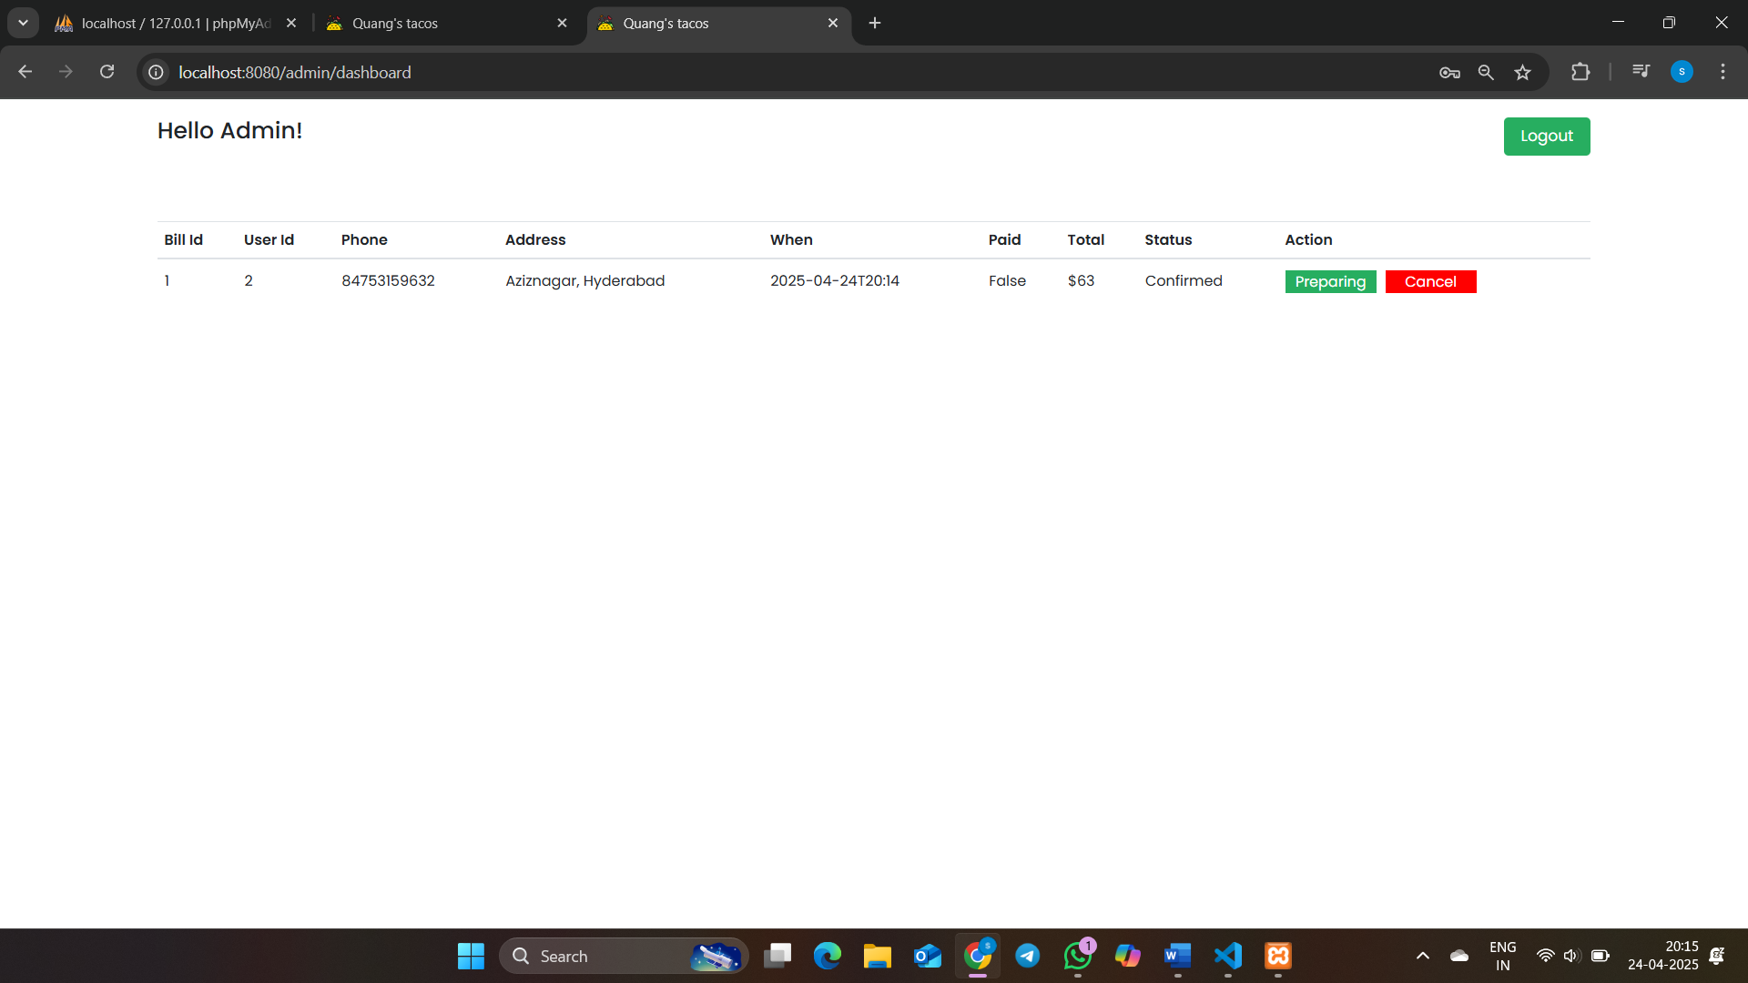
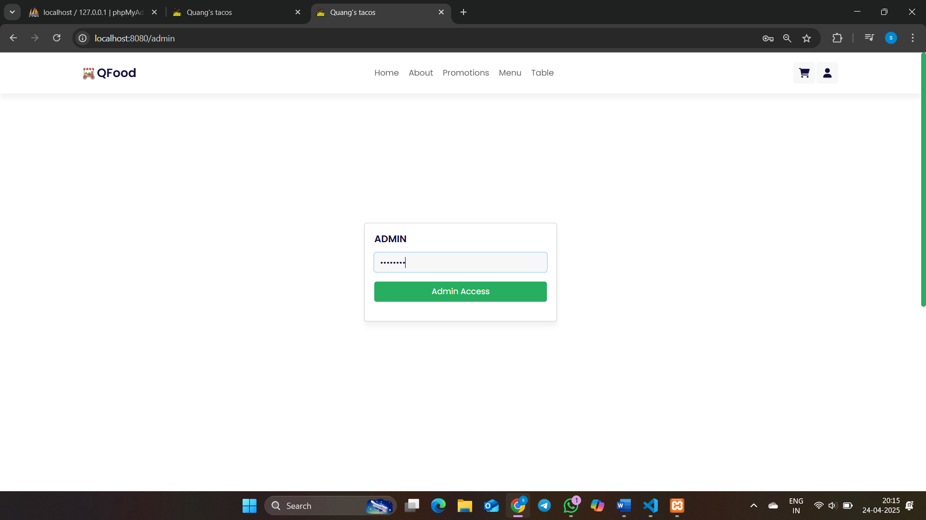

Slide 9
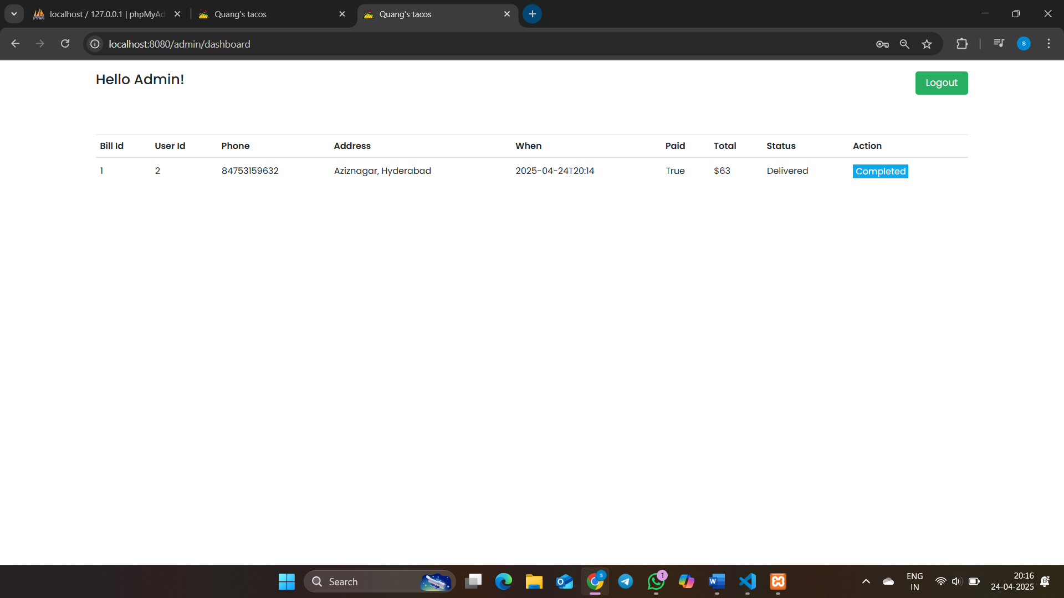
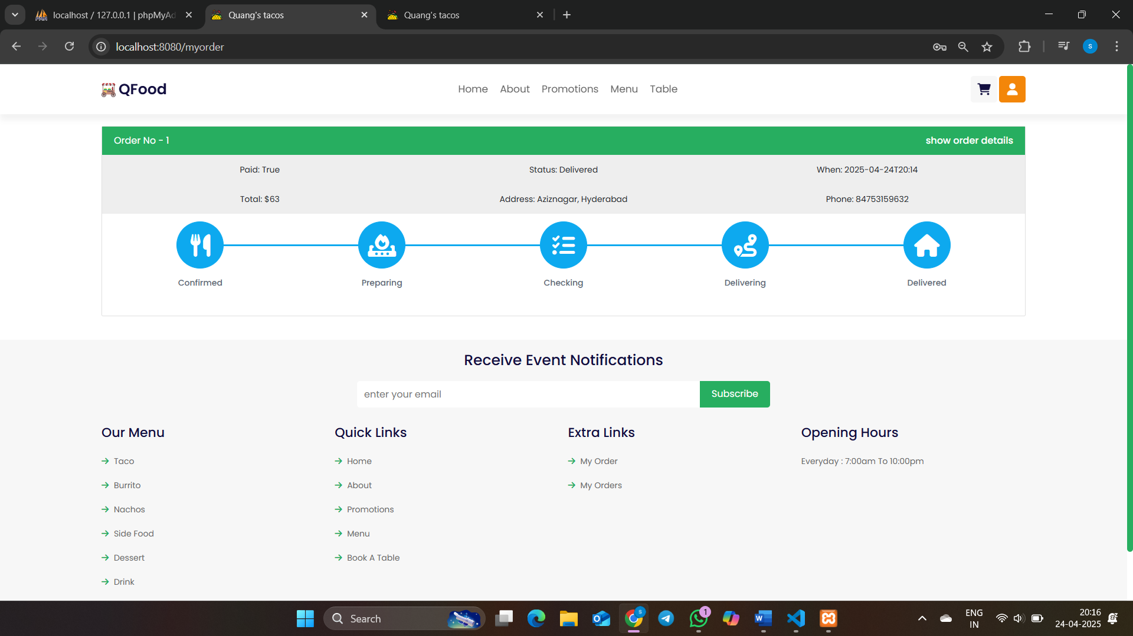

Slide 10
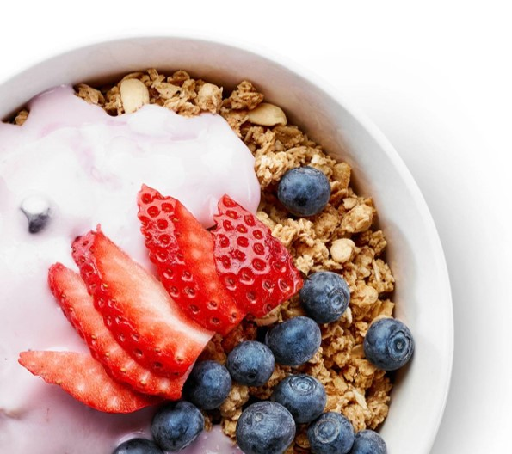
Success Metrics & Future Enhancements
Success Metrics:
✅ Order Placement Success Rate – 95%+ successful transactions
✅ Reservation Confirmation Accuracy – 98% accuracy
✅ System Uptime – 99.9% uptime during active hours
✅ User Satisfaction – 90%+ positive feedback (based on sample survey)
✅ Admin Efficiency – 80% reduction in manual tracking tasks
Future Enhancements:
Integrate online payment gateway
Add live order tracking for customers
Enable push notifications for real-time updates
Develop a mobile app version
Implement advanced analytics dashboard for admin insights

Slide 11
Conclusion
The Restaurant Reservation System successfully automates food ordering and table reservations, improving customer experience and operational flow.
With a 95%+ success rate in core functions and high user satisfaction, the system proves its effectiveness.
The architecture allows for easy future scaling and integration of advanced features, making it a future-ready solution for modern restaurants.

Slide 12
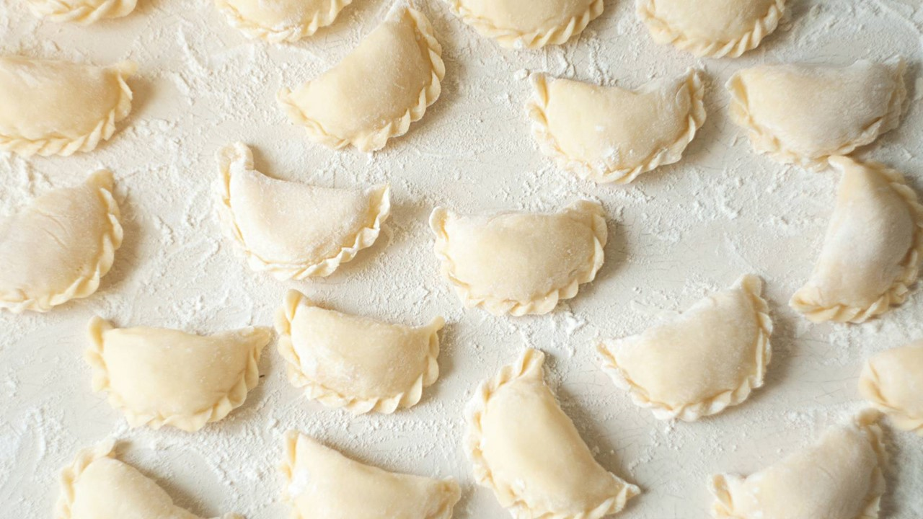
Thank You

